Slide 1


One to One and Recursive MSBA BAN 6020 Data Management
Carolina Salge

Slide 2
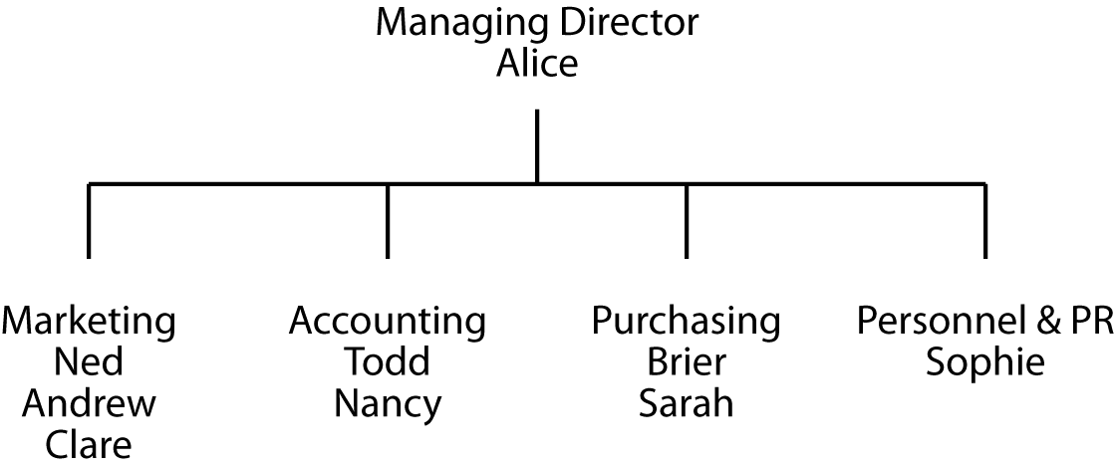
Organization Chart
Every structure for presenting data has an underlying data model

Slide 3
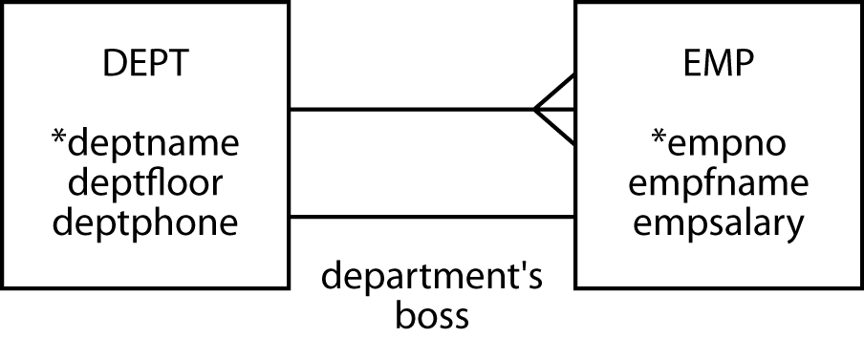
One to One
Label 1:1 relationship—the descriptor
Obvious relationships are not labelled

Slide 4
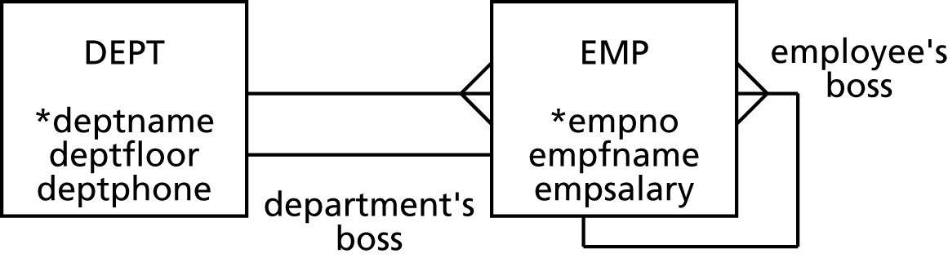
Recursive
Relates an entity to itself and need a label

Slide 5
Mapping Database
Usual rules apply
Where to place FK in 1:1 relationship
DEPT, EMP, or DEPT and EMP?
Entity gets an additional column for the FK in recursive relationship—need new name

Slide 6
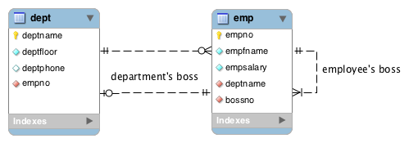
MySQL Workbench

Slide 7
Define a Table
create table dept (
deptname varchar(15),
deptfloor smallint not null,
deptphone smallint not null,
empno smallint not null,
primary key(deptname));
create table emp (
empno smallint,
empfname varchar(10),
empsalary decimal(7,0),
deptname varchar(15),
bossno smallint,
primary key(empno),
constraint fk_has_dept foreign key(deptname) references dept(deptname)),
constraint fk_has_boss foreign key(bossno) references emp(empno));
There is not foreign key constraint for empno in dept, because it requires the matching primary key in emp to exist. However, the matching foreign key in emp can't be created until the matching primary key in dept exists. An infinite circle of references.

Slide 8
Insert Rows
insert into emp (empno, empfname, empsalary, deptname)
values (1,'Alice', 75000,'Management');
insert into emp values (2,'Ned', 45000,'Management');
insert into emp values (3,'Andrew',25000, 'Marketing');
insert into emp values (4,'Clare', 22000, 'Marketing');
insert into emp values (5,'Todd', 38000, 'Accounting');
insert into emp values (6,'Nancy', 22000,'Accounting');
insert into emp values (7,'Brier', 43000,'Purchasing');
insert into emp values (8,'Sarah', 56000,'Purchasing');
insert into emp values (9,'Sophie', 35000,'Personnel');
Order inserts to avoid referential integrity issues

Slide 9
Query 1:1
List the salary of each department’s boss
select empfname, deptname, empsalary from emp
where empno in (select empno from dept);
select empfname, deptname, empsalary from emp, dept
where dept.empno = emp.empno;
empfname | deptname | empsalary
Alice | Management | 75000
Ned | Marketing | 45000
Todd | Accounting | 38000
Brier | Purchasing | 43000
Sophie | Personnel & PR | 35000

Slide 10
Recursive Join
Find the salary of Nancy’s boss
wk
empno | empfname | empsalary | deptname | bossno
1 | Alice | 75000 | Management
2 | Ned | 45000 | Marketing | 1
3 | Andrew | 25000 | Marketing | 2
4 | Clare | 22000 | Marketing | 2
5 | Todd | 38000 | Accounting | 1
6 | Nancy | 22000 | Accounting | 5
7 | Brier | 43000 | Purchasing | 1
8 | Sarah | 56000 | Purchasing | 7
9 | Sophie | 35000 | Personnel & PR | 1
boss
empno | empfname | empsalary | deptname | bossno
1 | Alice | 75000 | Management
2 | Ned | 45000 | Marketing | 1
3 | Andrew | 25000 | Marketing | 2
4 | Clare | 22000 | Marketing | 2
5 | Todd | 38000 | Accounting | 1
6 | Nancy | 22000 | Accounting | 5
7 | Brier | 43000 | Purchasing | 1
8 | Sarah | 56000 | Purchasing | 7
9 | Sophie | 35000 | Personnel & PR | 1

Slide 11
Query Recursive
Find the salary of Nancy’s boss
select wk.empfname, wk.empsalary, boss.empfname, boss.empsalary from emp wk, emp boss
where wk.empfname = 'Nancy'
and wk.bossno = boss.empno;
wk
empno | empfname | empsalary | deptname | bossno
1 | Alice | 75000 | Management
2 | Ned | 45000 | Marketing | 1
3 | Andrew | 25000 | Marketing | 2
4 | Clare | 22000 | Marketing | 2
5 | Todd | 38000 | Accounting | 1
6 | Nancy | 22000 | Accounting | 5
7 | Brier | 43000 | Purchasing | 1
8 | Sarah | 56000 | Purchasing | 7
9 | Sophie | 35000 | Personnel & PR | 1
boss
empno | empfname | empsalary | deptname | bossno
1 | Alice | 75000 | Management
2 | Ned | 45000 | Marketing | 1
2 | Ned | 45000 | Marketing | 1
1 | Alice | 75000 | Management
5 | Todd | 38000 | Accounting | 1
1 | Alice | 75000 | Management
7 | Brier | 43000 | Purchasing | 1
1 | Alice | 75000 | Management

Slide 12
Query Recursive
List employees earning more than their boss
Which relationship is this question about?
If you were to join, which keys would you need?
Do you need to join to answer this question?

Slide 13
Query Recursive
List employees earning more than their boss
select wk.empfname from emp wk, emp boss
where wk.empsalary > boss.empsalary
and wk.bossno = boss.empno;
wk
empno | empfname | empsalary | deptname | bossno
1 | Alice | 75000 | Management
2 | Ned | 45000 | Marketing | 1
3 | Andrew | 25000 | Marketing | 2
4 | Clare | 22000 | Marketing | 2
5 | Todd | 38000 | Accounting | 1
6 | Nancy | 22000 | Accounting | 5
7 | Brier | 43000 | Purchasing | 1
8 | Sarah | 56000 | Purchasing | 7
9 | Sophie | 35000 | Personnel & PR | 1
boss
empno | empfname | empsalary | deptname | bossno
1 | Alice | 75000 | Management
2 | Ned | 45000 | Marketing | 1
2 | Ned | 45000 | Marketing | 1
1 | Alice | 75000 | Management
5 | Todd | 38000 | Accounting | 1
1 | Alice | 75000 | Management
7 | Brier | 43000 | Purchasing | 1
1 | Alice | 75000 | Management

Slide 14
Recursive Template
List employees earning more than their boss
List X earning more than their Y
select wk.empfname from emp wk, emp boss
where wk.empsalary > boss.empsalary
and wk.bossno = boss.empno;
select <X.NAME> from <ENTITY X>, < ENTITY Y>
where <X.SALARY> > <Y.SALARY>
and <X.FK> = <Y.PK>;
# Y usually refers to the label in the recursive relationship, which is often matched with the PK

Slide 15
Exercise
Find the names of employees in the same department as their boss

Slide 16
Note to Carolina
Stop here! Finish chapter 6 next class

Slide 17
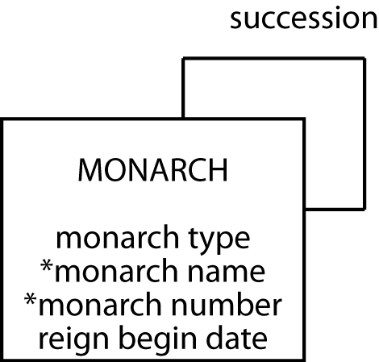
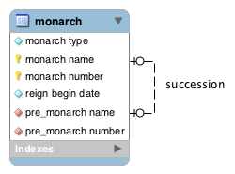
One to One Recursive
The English Monarch

Slide 18
Mapping Database
Usual rules apply
monarch
montype | monname | monnum | rgnbeg | premonname | premonnum
Queen | Victoria | I | 1837/6/20 | William | IV
King | Edward | VII | 1901/1/22 | Victoria | I
King | George | V | 1910/5/6 | Edward | VII
King | Edward | VIII | 1936/1/20 | George | V
King | George | VI | 1936/12/11 | Edward | VIII
Queen | Elizabeth | II | 1952/2/6 | George | VI

Slide 19
Exercise
Design a database to record details of all Olympic cities
A city can host an Olympics more than once, though a particular Olympics is in only one city at a time
Each Olympics has only one predecessor and successor

Slide 20
Query 1:1 Recursive
Who preceded Elizabeth II?
monarch
montype | monname | monnum | rgnbeg | premonname | premonnum
Queen | Victoria | I | 1837/6/20 | William | IV
King | Edward | VII | 1901/1/22 | Victoria | I
King | George | V | 1910/5/6 | Edward | VII
King | Edward | VIII | 1936/1/20 | George | V
King | George | VI | 1936/12/11 | Edward | VIII
Queen | Elizabeth | II | 1952/2/6 | George | VI

Slide 21
Query 1:1 Recursive
Who preceded Elizabeth II?
select premonname, premonnum from monarch
where monname = 'Elizabeth'
and monnum = 'II';
monarch
montype | monname | monnum | rgnbeg | premonname | premonnum
Queen | Victoria | I | 1837/6/20 | William | IV
King | Edward | VII | 1901/1/22 | Victoria | I
King | George | V | 1910/5/6 | Edward | VII
King | Edward | VIII | 1936/1/20 | George | V
King | George | VI | 1936/12/11 | Edward | VIII
Queen | Elizabeth | II | 1952/2/6 | George | VI

Slide 22
Query 1:1 Recursive
Was Elizabeth II’s predecessor a king?
monarch
montype | monname | monnum | rgnbeg | premonname | premonnum
Queen | Victoria | I | 1837/6/20 | William | IV
King | Edward | VII | 1901/1/22 | Victoria | I
King | George | V | 1910/5/6 | Edward | VII
King | Edward | VIII | 1936/1/20 | George | V
King | George | VI | 1936/12/11 | Edward | VIII
Queen | Elizabeth | II | 1952/2/6 | George | VI

Slide 23
Query 1:1 Recursive
Was Elizabeth II’s predecessor a king?
select pre.montype from monarch post, monarch pre
where post.premonname = pre.monname
and post.premonnum = pre.monnum
and post.monname = 'Elizabeth'
and post.monnum = 'II';
post
montype | monname | monnum | rgnbeg | premonname | premonnum
Queen | Victoria | I | 1837/6/20 | William | IV
King | Edward | VII | 1901/1/22 | Victoria | I
King | George | V | 1910/5/6 | Edward | VII
King | Edward | VIII | 1936/1/20 | George | V
King | George | VI | 1936/12/11 | Edward | VIII
Queen | Elizabeth | II | 1952/2/6 | George | VI
pre
montype | monname | monnum | rgnbeg | premonname | premonnum
King | William | IV | 1830/6/26
Queen | Victoria | I | 1837/6/20 | William | IV
King | Edward | VII | 1901/1/22 | Victoria | I
King | George | V | 1910/5/6 | Edward | VII
King | Edward | VIII | 1936/1/20 | George | V
King | George | VI | 1936/12/11 | Edward | VIII

Slide 24
Exercises
List every monarch in alphabetical order
Use the Olympic cities data model that you developed to hypothetically answer (in MS Word) the following SQL questions:
Which city was the host before the 2008 Summer London Olympics?
Report the year of the Olympics prior to the 2008 Summer London Olympics
select * from monarch order by rgnbeg;

Slide 25
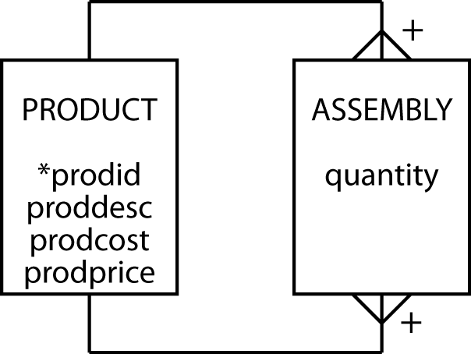
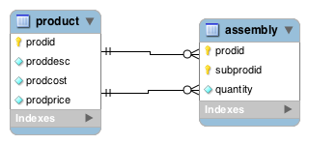
Many to Many Recursive
Bill of materials problem
A product can be composed of many products and can appear as part of many other products

Slide 26


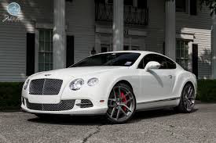
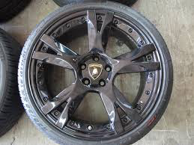
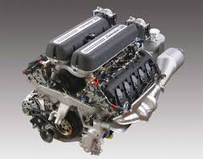

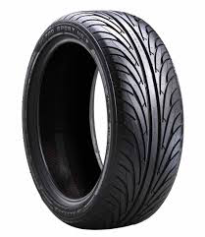

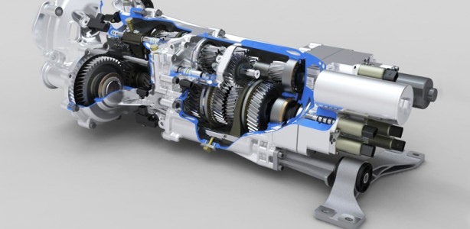
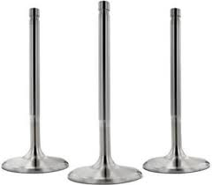

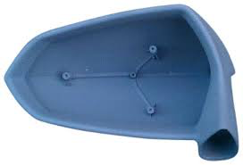
Many to Many Recursive
tire rubber
tire rim
transmission
valve
glass
cover

Slide 27
Mapping Database
Usual rules apply
product
prodid | proddesc | prodcost | prodprice
1000 | Animal photography kit |  | 725
101 | Camera | 150 | 300
102 | Camera case | 10 | 15
103 | 70-210 zoom lens | 125 | 200
104 | 28-85 zoom lens | 115 | 185
105 | Photographer’s vest | 25 | 40
106 | Lens cleaning cloth | 1 | 1.25
107 | Tripod | 35 | 45
108 | 16 GB SDHC memory card | 30 | 30
assembly
quantity | prodid | subprodid
1 | 1000 | 101
1 | 1000 | 102
1 | 1000 | 103
1 | 1000 | 104
1 | 1000 | 105
2 | 1000 | 106
1 | 1000 | 107
4 | 1000 | 108

Slide 28
Query M:M Recursive
List the product description and cost of each component of the animal photography kit
select proddesc, prodcost from product where prodid in (select subprodid from product, assembly
where proddesc = 'Animal photography kit'
and product.prodid = assembly.prodid);
proddesc | prodcost
Camera | 150
Camera case | 10
70-210 zoom lens | 125
28-85 zoom lens | 115
Photographer’s vest | 25
Lens cleaning cloth | 1
Tripod | 35
16 GB SDHC memory card | 30

Slide 29
Query M:M Recursive
List the product description and cost of each component of the animal photography kit
select comp.proddesc, comp.prodcost from product prod, product comp, assembly where prod.prodid = assembly.prodid and comp.prodid = assembly.subprodid and prod.proddesc = 'Animal photography kit'
prod
prodid | proddesc | prodcost | prodprice
1000 | Animal photography kit |  | 725
101 | Camera | 150 | 300
102 | Camera case | 10 | 15
103 | 70-210 zoom lens | 125 | 200
104 | 28-85 zoom lens | 115 | 185
105 | Photographer’s vest | 25 | 40
106 | Lens cleaning cloth | 1 | 1.25
107 | Tripod | 35 | 45
108 | 16 GB SDHC memory card | 30 | 30
comp
prodid | proddesc | prodcost | prodprice
1000 | Animal photography kit |  | 725
101 | Camera | 150 | 300
102 | Camera case | 10 | 15
103 | 70-210 zoom lens | 125 | 200
104 | 28-85 zoom lens | 115 | 185
105 | Photographer’s vest | 25 | 40
106 | Lens cleaning cloth | 1 | 1.25
107 | Tripod | 35 | 45
108 | 16 GB SDHC memory card | 30 | 30
assembly
quantity | prodid | subprodid
1 | 1000 | 101
1 | 1000 | 102
1 | 1000 | 103
1 | 1000 | 104
1 | 1000 | 105
2 | 1000 | 106
1 | 1000 | 107
4 | 1000 | 108

Slide 30
Recap
Introduced
Recursive Relationship
Self-referential constraint
Recursive Join

Slide 31
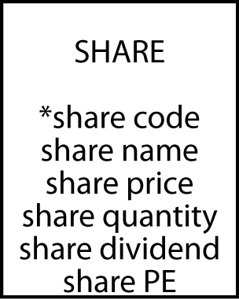
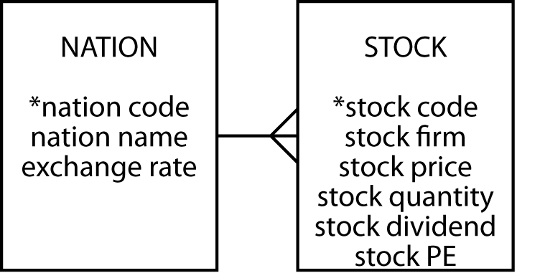

Next Class
Data Modeling (7)

